Slide 1

Web Development & Design Foundations with H T M L 5
Ninth Edition
Chapter 7
More on Links, Layout, and Mobile
Slides in this presentation contain hyperlinks. JAWS users should be able to get a list of links by using INSERT+F7
Copyright © 2019, 2017, 2015 Pearson Education, Inc. All Rights Reserved
Notes:
If this PowerPoint presentation contains mathematical equations, you may need to check that your computer has the following installed:
1) MathType Plugin
2) Math Player (free versions available)
3) NVDA Reader (free versions available)

Slide 2
Learning Objectives (1 of 2)
7.1 Code relative hyperlinks to web pages in folders within a website
7.2 Configure a hyperlink to a named fragment internal to a web page
7.3 Configure images with C S S sprites
7.4 Configure a three-column page layout using C S S
7.5 Configure C S S for printing
7.6 Describe mobile design best practices

Slide 3
Learning Objectives (2 of 2)
7.7 Configure web pages for mobile display using the viewport meta tag
7.8 Apply responsive web design techniques with C S S 3 media queries and flexible images
7.9 Describe C S S Flexible Box Layout (and code an example)
7.10 Describe C S S Grid Layout (and code an example)

Slide 4
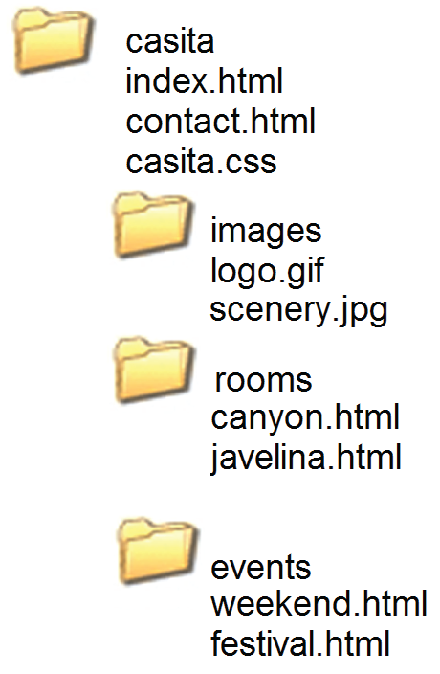
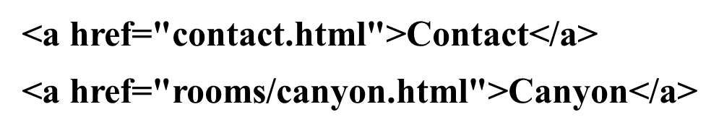
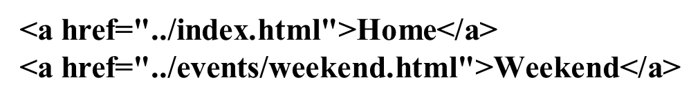
More on Relative Linking
Relative links from the Home page: index.html
Relative links from the Canyon page: rooms/canyon.html

Slide 5
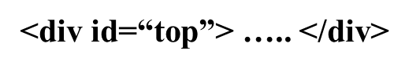
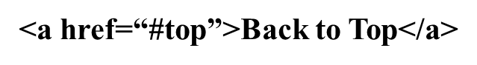

H T M L Linking to Fragment Identifiers
A link to a part of a web page
Also called named fragments, fragment ids
Two components:
The tag that identifies the named fragment of a web page. This requires the id attribute.
The anchor tag that links to the named fragment of a web page. This uses the href attribute.

Slide 6

Opening a Link in a New Browser Window
The target attribute on the anchor element opens a link in a new browser window or new browser tab.

Slide 7
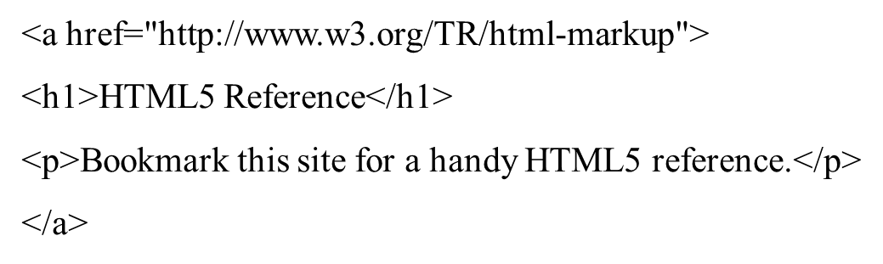
H T M L 5 Block Anchor
Configure block display elements within a hyperlink

Slide 8


Telephone & Text Message Hyperlinks
Telephone Scheme
Many mobile browsers will initiate a phone call when the hyperlink is clicked.
S M S Scheme
Many mobile browsers will initiate a text message to the phone number when the hyperlink is clicked.

Slide 9
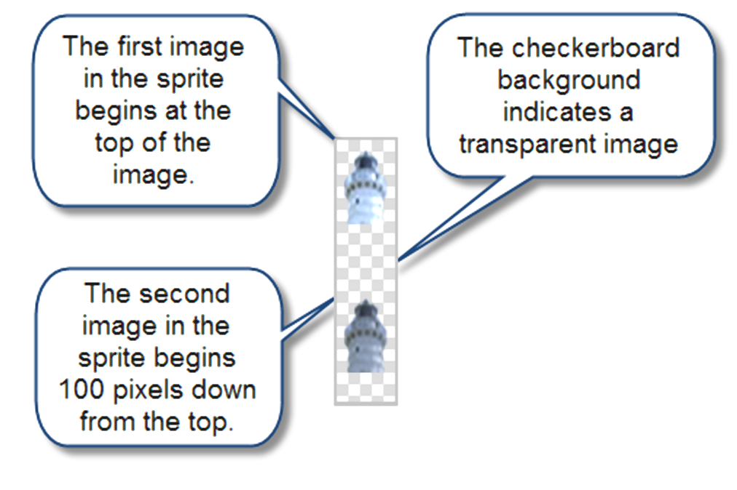
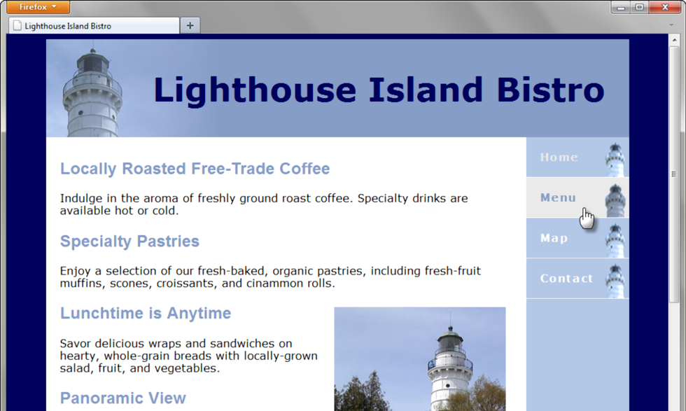
C S S Sprites
Sprite
an image file that contains multiple small graphics
advantage: saves download time

Slide 10
Checkpoint 7.1
Describe a reason to organize the files in a website using folders and subfolders.
Which attribute configures a hyperlink to open the file in a new browser window or tab?
State an advantage of using C S S sprites in a website.

Slide 11
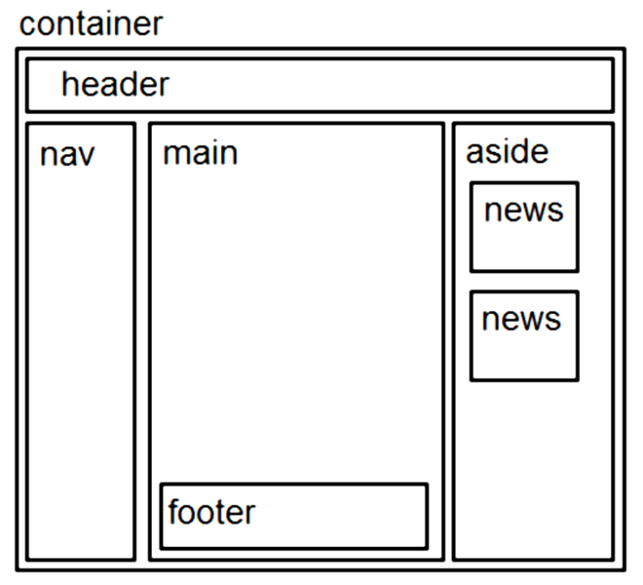
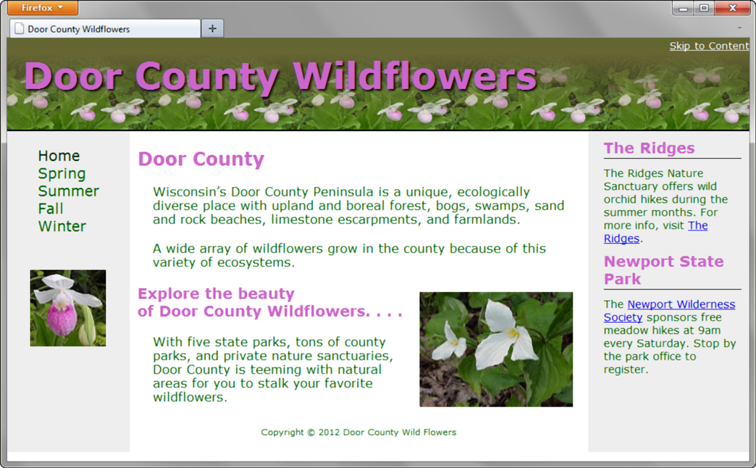
Three Column Page Layout
A common web page layout consists of a header across the top of the page with three columns below: navigation, content, and sidebar.

Slide 12


Three Column Layout
container sets default background color, text color, font typeface, and a minimum width
Left-column navigation
float: left; width:150px;
Right-column content
float: right; width: 200px;
Center column
Uses the remaining screen room available room after the floating columns display
margin: 0 210px 0 160px;
Footer – clears the float
clear: both;

Slide 13

C S S Styling for Print
Create an external style sheet with the configurations for browser display.
Create a second external style sheet with the configurations for printing.
Connect both of the external style sheets to the web page using two <link > elements.

Slide 14
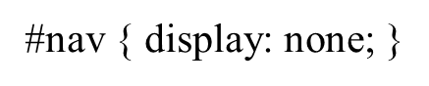
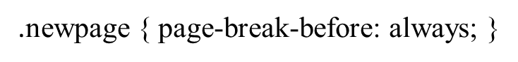

Print Styling Best Practices
Hide non-essential content Example:
Configure font size and color for printing
Use pt font sizes, use dark text color
Control page breaks
Example:
Print U R L s for hyperlinks Example:

Slide 15

Mobile Web Limitations
Small Screen Size
Low bandwidth
Limited fonts
Limited color
Awkward controls
Lack of Flash support
Limited processor and memory
Cost per kilobyte

Slide 16
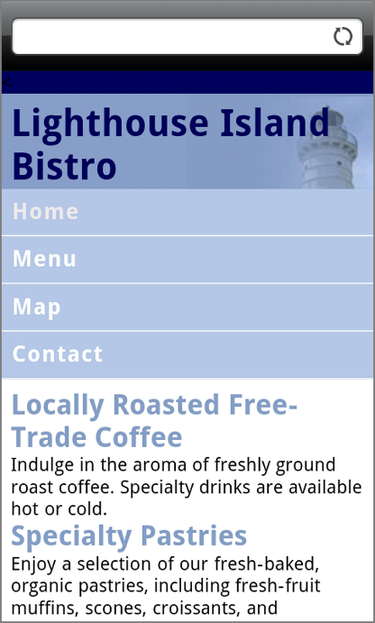
Mobile Web Design Best Practices
Recommended by the W3C
http://www.w3.org/TR/mobile-bp
http://www.w3.org/2007/02/mwbp_flip_cards.html
Optimize Layout, Navigation, Graphics, and Text for Mobile Use
Design for One Web

Slide 17
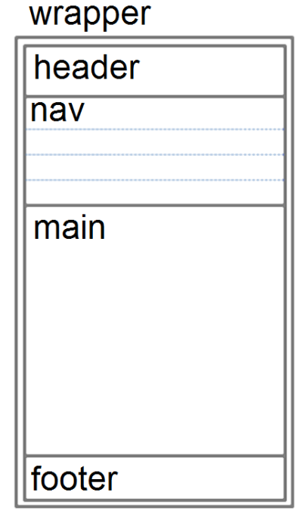
Optimize Layout for Mobile Use
Single column design
Limit scrolling to one direction
Use heading elements
Use lists
Avoid using tables
Provide labels for form controls
Avoid using pixel units in style sheets
Avoid absolute positioning in style sheets
Hide content that is not essential for mobile use.

Slide 18

Optimize Navigation for Mobile Use
Provide minimal navigation near the top of the page
Provide consistent navigation
Avoid hyperlinks that open files in new windows or pop-up windows
Try to balance both the number of hyperlinks on a page and the number of levels needed to access information

Slide 19
Optimize Graphics for Mobile Use
Avoid displaying images that are wider than the screen width
Configure alternate, small optimized background images
Some mobile browsers will downsize all images, so avoid using images that contain text
Avoid the use of large graphic images
Specify the size of images
Provide alternate text for graphics and other non-text elements.

Slide 20
Optimize Text for Mobile Use
Configure good contrast between text and background colors
Use common font typefaces
Configure font size with em units or percentages
Use a short, descriptive page title

Slide 21
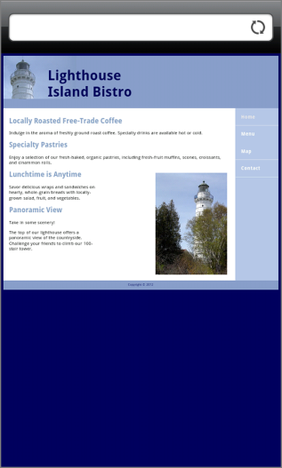

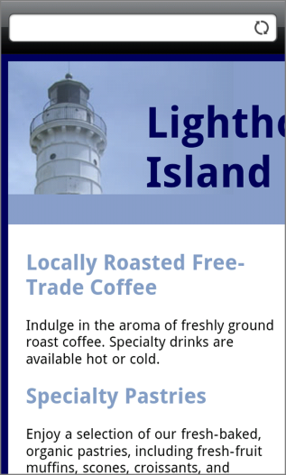
Viewport Meta Tag
Default action for most mobile devices is to zoom out and scale the web page
Viewport Meta Tag
Created as an Apple extension to configure display on mobile devices
Configures width and initial scale of browser viewport

Slide 22
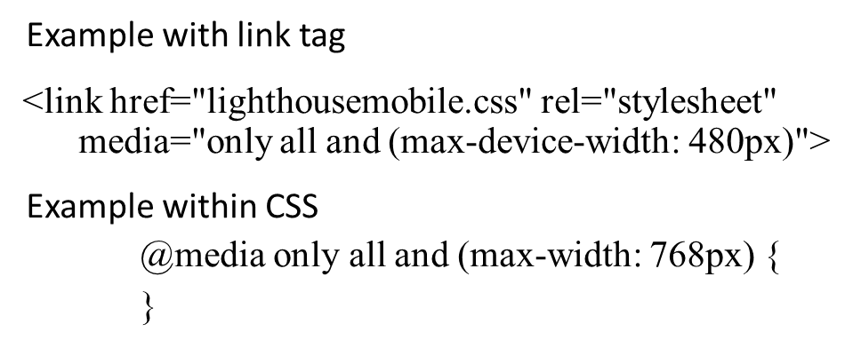
C S S3 Media Queries
Media Query
Determines the capability of the mobile device, such as screen resolution
Directs the browser to styles configured specifically for those capabilities

Slide 23
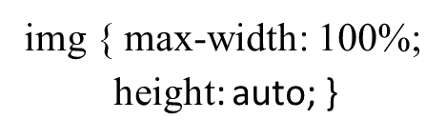
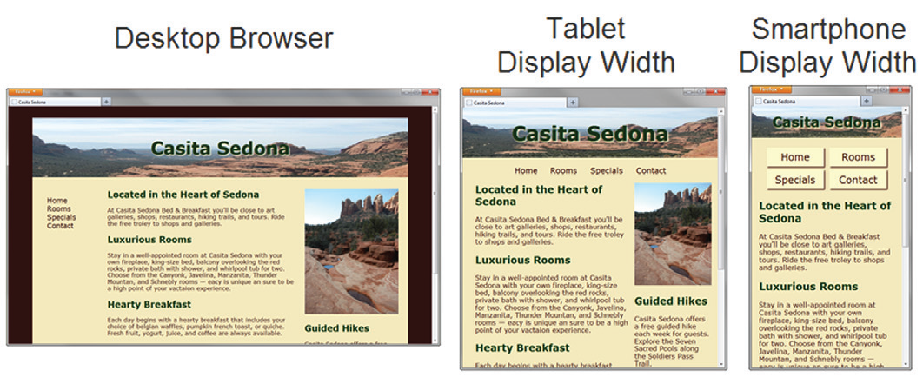
Flexible Images
Edit H T M L: remove height and width attributes
C S S:

Slide 24
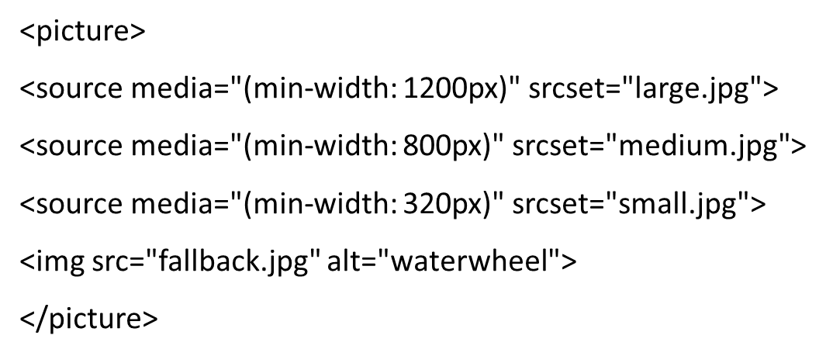
Responsive Images H T M L 5.1 Picture Element

Slide 25
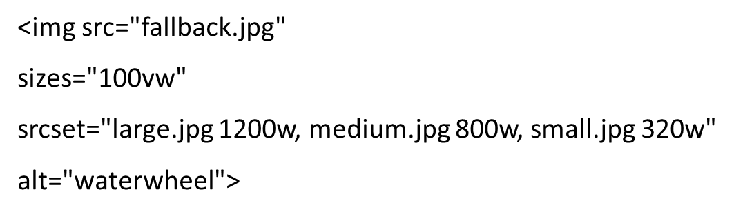
Responsive Images H T M L 5.1 Sizes & Srcset Attributes

Slide 26

Testing Mobile Display Options
Test with a mobile device
Emulators
Opera Mobile Emulator
Mobilizer
iPhone Emulator
Test with a Desktop Browser
Install an i O S or Android S D K

Slide 27
C S S Flexible Box Layout Module
Referred to as “flexbox”
Provides for a flexible layout
Elements contained within a flex container can be configured either horizontally or vertically in a flexible manner with flexible sizing
Check http://caniuse.com/flexbox for the current level of browser support.
Common Properties used with flexbox:
display
flex-direction
flex-wrap
flex
order
justify-content

Slide 28
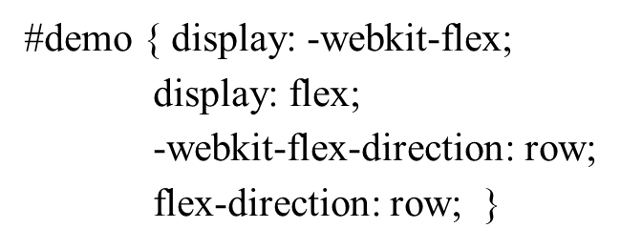
Using Flexbox (1 of 2)
Configure a flexible container “flex container”
Configure the direction of the flex
Example:

Slide 29
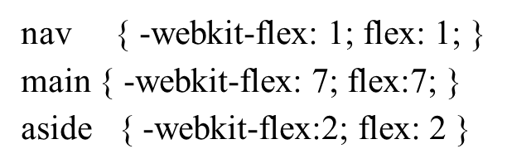
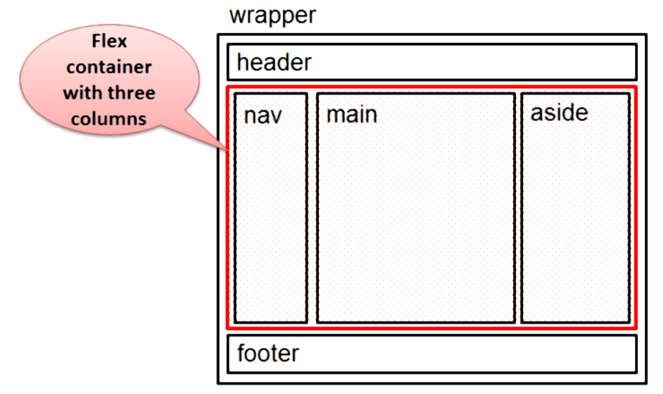
Using Flexbox (2 of 2)
Adjust the proportion of the “flex item” elements in the container
Example:

Slide 30
C S S Grid Layout Module
Configures a two-dimensional grid-based page layout
Elements contained within a flex container can be configured either horizontally or vertically in a flexible manner with flexible sizing
Check http://caniuse.com/css-grid for the current level of browser support.
Common Properties used with flexbox:
display
grid-template-columns
grid-template-rows
grid-row
grid-column

Slide 31
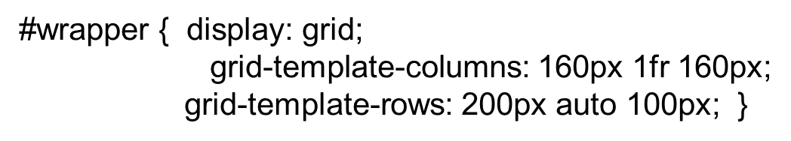
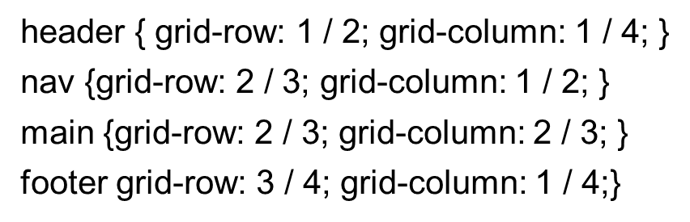
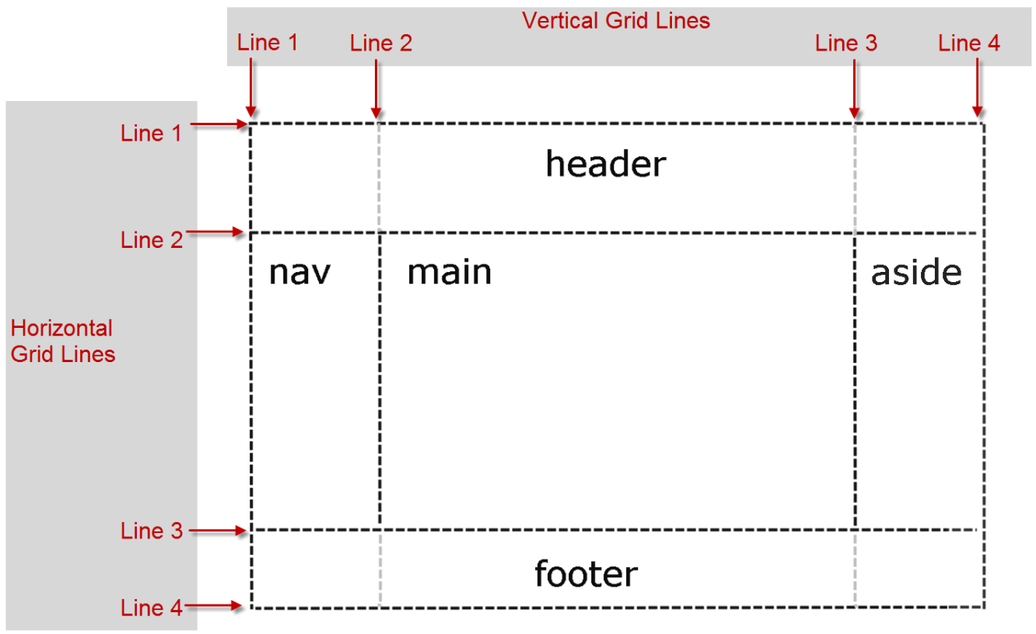
Using Grid
Configure a grid container and dimensions:
Configure grid location for each item in the grid:

Slide 32
C S S Debugging Tips
Manually check syntax errors
Use W 3 C C S S Validator to check syntax errors
http://jigsaw.w3.org/css-validator/
Configure temporary background colors
Configure temporary borders
Use C S S comments to find the unexpected
/* the browser ignores this code */
Don’t expect your pages to look exactly the same in all browsers!
Be patient!

Slide 33
Checkpoint 7.2
State an advantage of using C S S to style for print.
Describe a design consideration when configuring a web page for mobile display.
Describe coding techniques that will configure an image with a flexible display.

Slide 34
Summary
This chapter introduced you to a variety of topics related to hyperlinks, page layout, and configuring responsive web pages that display well on desktop browsers and mobile devices.

Slide 35
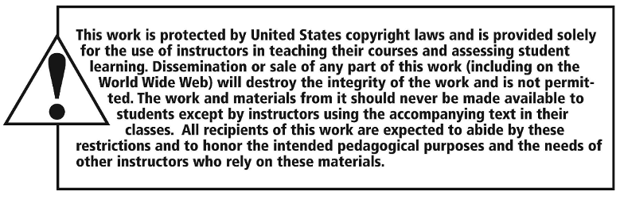
Copyright

